Slide 1
WOMBAT Tutorial
NAWEA WindTech
Rob Hammond
2 November 2023

Slide 2
WOMBAT At a Glance
Configuring WOMBAT
COREWIND Assumptions
Setting Up a Simulation
Hands-on With WOMBAT
Time Permitting: WAVES
Time Permitting: Future of WOMBAT

Slide 3
WOMBAT At a Glance

Slide 4
Relevance of O&M Costs
O&M activities are estimated to comprise between 29% and 34% of total wind plant lifecycle costs (Stehly & Beiter, 2018).
$33 – $59/kW/year for land-based wind
$65 – $194/kw/year for offshore wind
Innovations in the O&M sector have the potential to drive down the overall cost of wind energy.
However, quantifying the impact of these innovations on cost is challenging because:
Data on wind plant O&M costs are not often publicly available or broken down into detailed categories.
Understanding cost impacts and tradeoffs for O&M strategies requires a model with appropriate resolution to capture relatively small changes at the level of individual tasks.

Slide 5
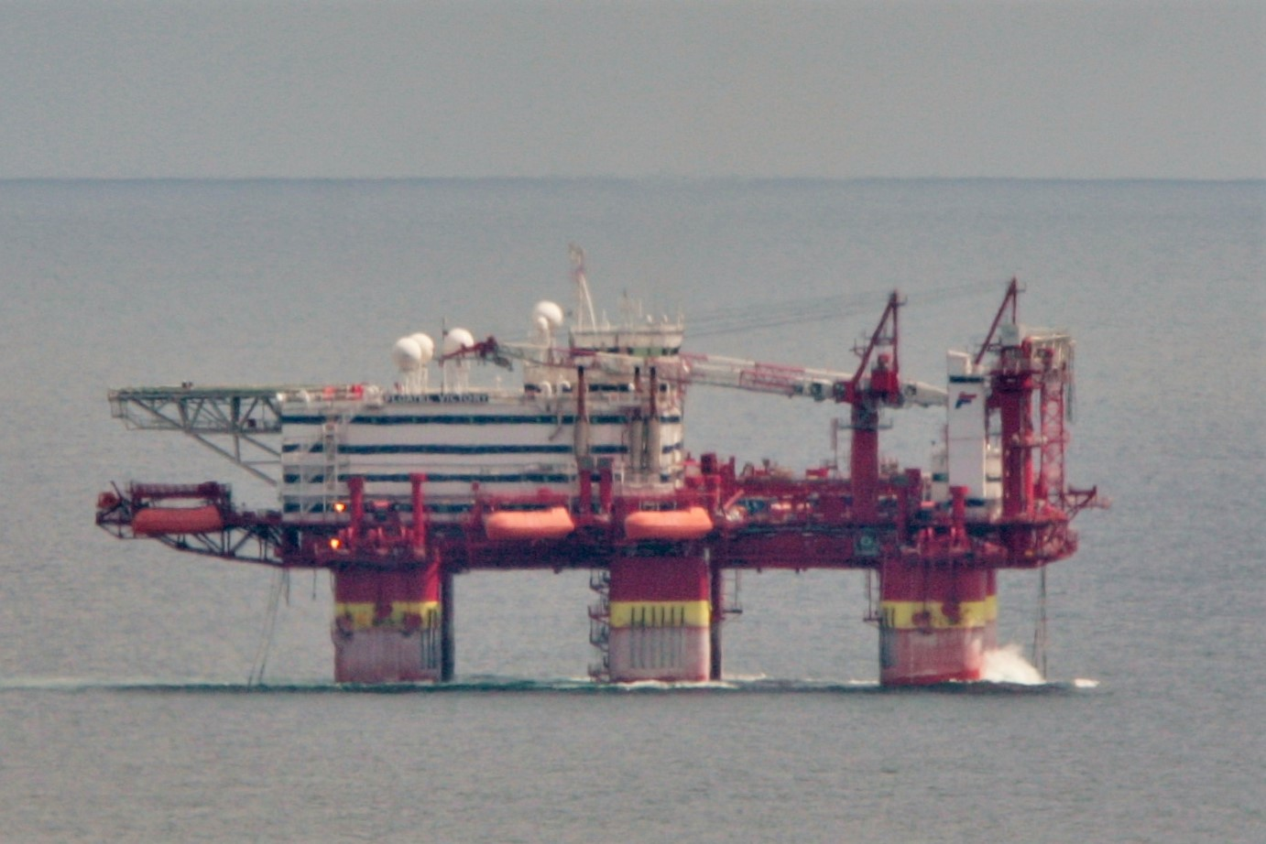

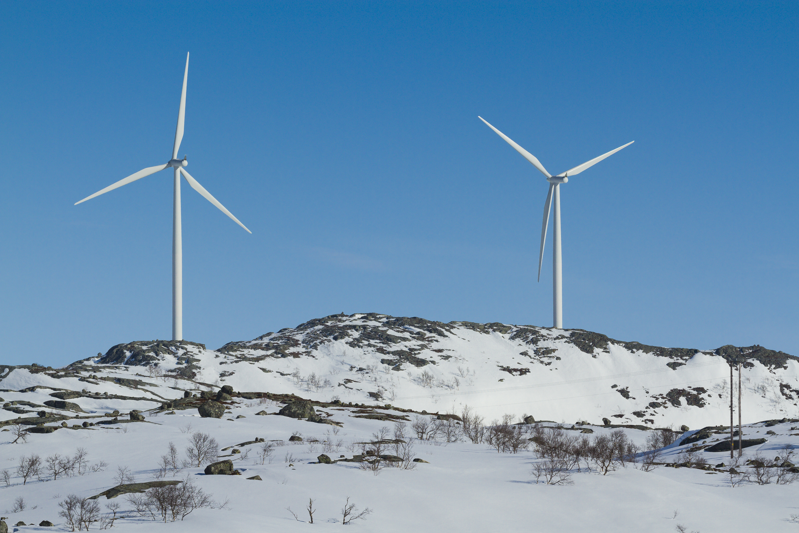
Primary Research Question
How might maintenance strategies, technological innovations, and site conditions influence wind plant OpEx and ultimately LCOE?
Methodology Innovations
Technology Innovations
Site Conditions
Notes:
How do different O&M strategies, technological and methodological innovations, and site-specific conditions impact the overall OpEx costs, and in turn LCOE, for a given land-based or offshore windfarm?

Slide 6
Approach
Minimal code by the user to actual run the model
Empower a broad user base by requiring minimal Python skills
Configure models through YAML files, not complicated setup code
Prescriptive modeling via discrete event simulation:
Enables weather and site-specific variability
Allows a user to define O&M strategies to understand cost and energy impacts
Focuses on what-if scenario modeling instead of optimization
Modular and flexible code base:
Allows for new methodologies to be tested with ease
Provides a tool to analyze both offshore and land-based windfarm O&M costs
Allows users to define their turbine failure models in as much or as little detail as desired
Documentation driven development:
Use of inline comments and docstrings explains what nearly all functionality is supposed to be doing
Enables easier modification or improvement for researchers and/or developers

Slide 7
High-Level Software Architecture
Wind Farm Model
Core Model
Systems
Cables
Turbines
Substations
Environment
Data Classes
Repair Manager
Simulation API
Electrical System
Electronic Control
Yaw System
Cable
Transformer
Port
Post Processing
Hydraulic System
Rotor Blades
Generator
Example Subassemblies
Servicing Equipment
Sensors
Gearbox
Mechanical Brake
Supporting Structure
Drivetrain
Rotor Hub

Slide 8
High-Level Simulation Architecture
Model evaluates O&M costs using discrete event simulation (series of events in sequential order where no changes occur between events):
Allows for detailed documentation of a system and its processes.
Allows for a prescriptive approach for exploring specific impacts compared to an optimization with a “best choice.”
Wind (and wave) time series
Wait for weather, equipment, parts*
Start simulation
Subassembly
System
Repair Manager
Servicing Equipment
Subassembly
System
End simulation
Fails or reaches maintenance interval
Requests service
Assigns task
Conducts service
Resets status
Returns to operation
Accumulate downtime (failures only)
Track O&M costs
*Parts availability not yet implemented

Slide 9
Configuring WOMBAT

Slide 10
Repairs and Maintenance
Maintenance (scheduled)
Fixed frequency model (number of days) to align with regular servicing intervals
Failures (unscheduled maintenance)
Weibull distribution (exponential if using 1 for the shape parameter)
Scale = 1 / (# Failures/system/year) = MTBF (in years)
Random sampling for the next time a failure occurs
Shared parameterizations
Materials cost (whole cost or proportional to system CapEx)
Repair time
Service equipment categories that can perform corrective maintenance
CTV, DRN, RMT, SCN, LCN, CAB, DSV, TOW, AHV
Operating reduction
Severity level (helps prioritize repairs across the farm)

Slide 11
Servicing Equipment
Strategy
Scheduled
Unscheduled-downtime
Unscheduled-requests
Unscheduled-tow (offshore only)
Capabilities
Working hours
Mobilization
Port distance
Crew
Weather constraints
Windspeed
Waveheight
Speed (including during inclement weather)
Non-operational periods
Slow down periods

Slide 12
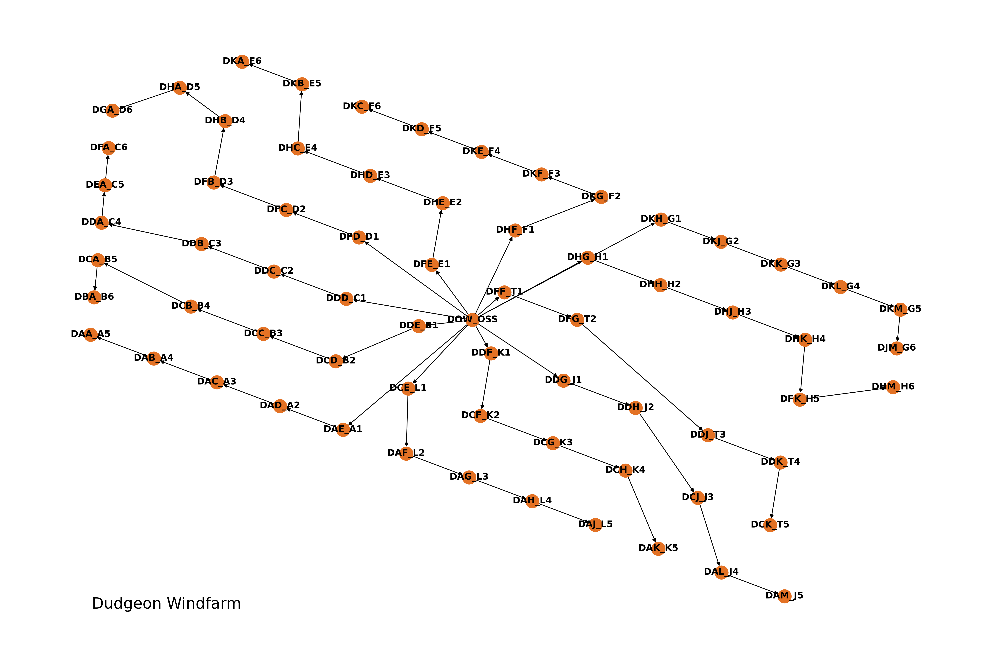
The Wind Farm
CSV Layout
Define each substation and turbine’s positions relative to each other and spatially (WGS-84 coordinates)
Provides pointers to the cable, substation, and turbine definition file
Gives names and IDs to each of the systems on the farm so that subassembly definitions can be shared between common systems

Slide 13
Baseline Inputs
Subassemblies
Failure rate(s)
Maintenance tasks
Equipment requirements
Cost and time to complete repairs
Power curve (if modeling energy production – IEC power curve)
Servicing Equipment
Maintenance strategy and related definitions
Port (if required)
Capabilities
Labor rates
Equipment rates
Operational limits
Miscellaneous
Weather profile
Hourly windspeed and/or wave height
Windfarm layout
Site working hours
Port distance

Slide 14
Outputs
Time-based availability
Production-based availability
Power production
Fixed costs
Capacity factor
Task completion rate
Service equipment costs
Service equipment utilization
Labor costs
Combined service equipment and labor costs by productivity
Component costs
Servicing time breakdown
OpEx
More on the way
High fidelity log files to compute further metrics
Event logs
Operating level logs (hourly)
Power production logs (hourly)
Power potential logs (hourly)

Slide 15
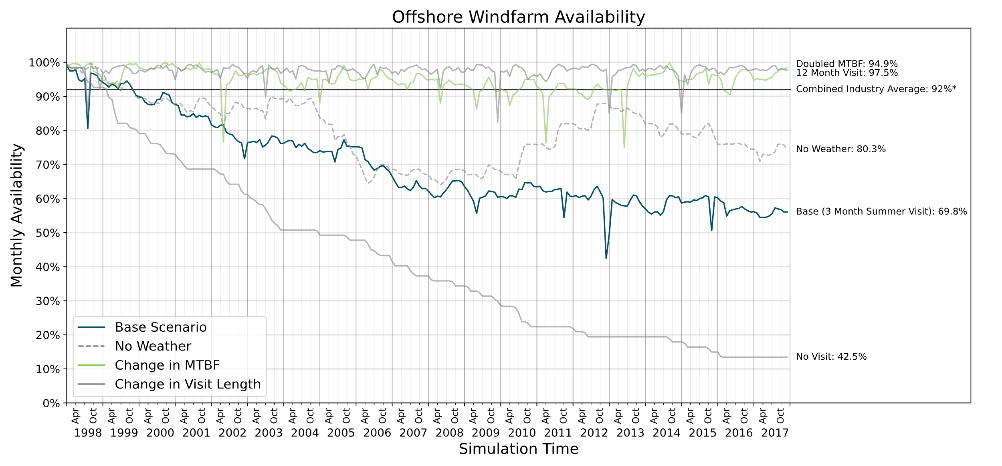
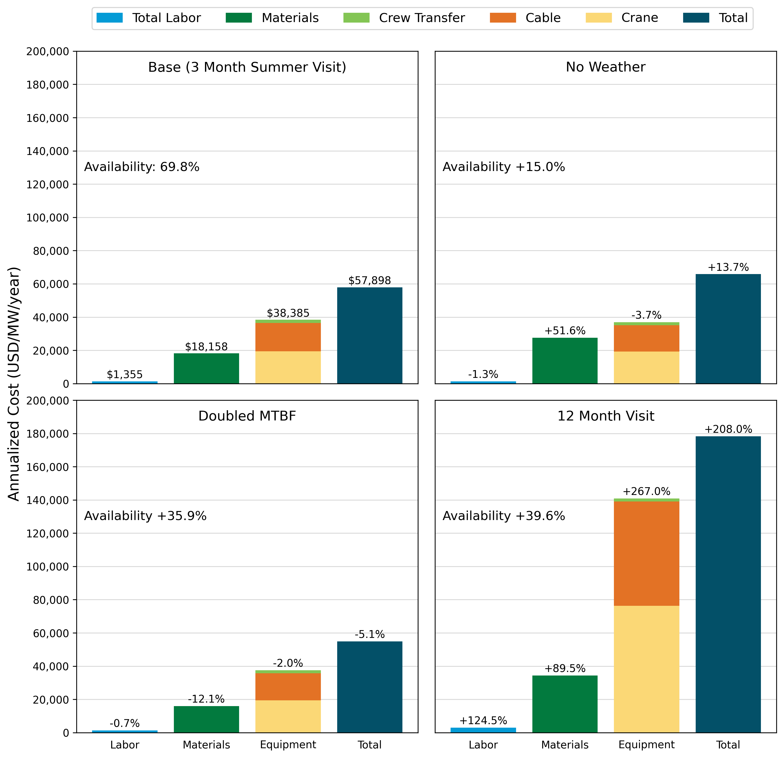
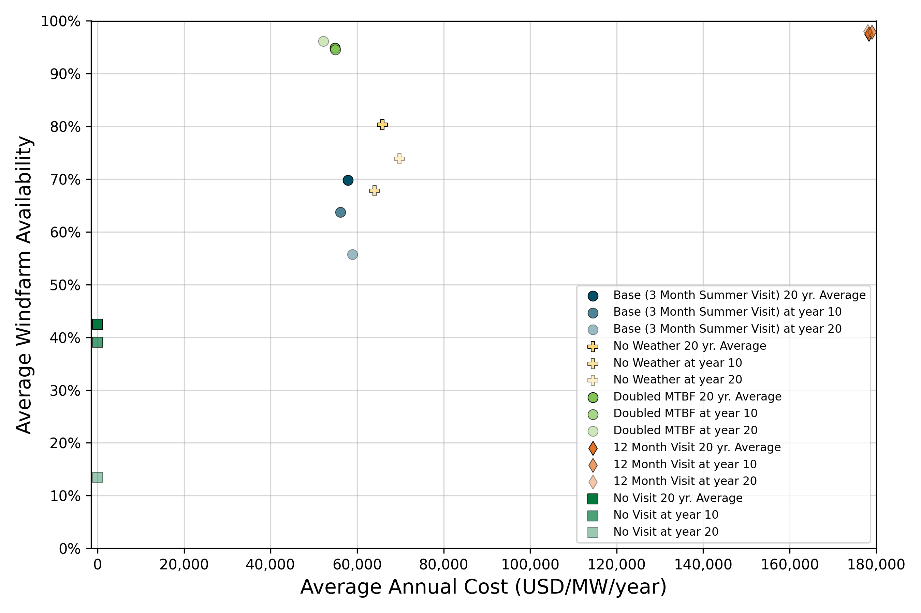
Examples

Slide 16
COREWIND Assumptions

Slide 17
High Level Information
Plant assumptions https://corewind.eu/wp-content/uploads/files/publications/COREWIND-D6.1-General-frame-of-the-analysis-and-description-of-the-new-FOW-assessment-app.pdf
Assessment assumptions https://corewind.eu/wp-content/uploads/files/publications/COREWIND-D4.2-Floating-Wind-O-and-M-Strategies-Assessment.pdf
Summary
1.2 GW in Morro Bay, CA with reference coordinate: (35. 367222, -121. 645163)
60km distance to shore
80 x IEA 15 MW Reference Turbines, but with floating platforms, spaced 2160m apart
2 offshore substations
7 CTVs, Anchor Handling Vessel, Diving Support Vessel, Cable Lay Vessel, ROV
Technician salary: €80K

Slide 18
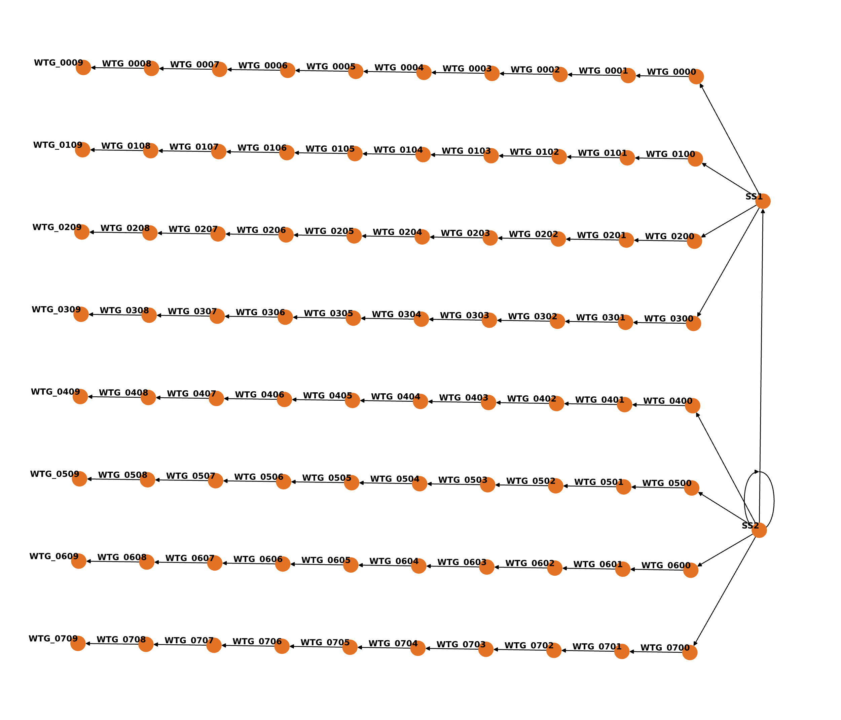
Plant Layout
Notes:
failure rates primarily from ECN tool and prior IEA Wind work
crane costs and sizes from LandBOSSE, vessel data from ORBIT

Slide 19
Failure Data
Data doesn’t quite match the expected format in WOMBAT
Some assumptions don’t quite align with expectations
So, how would this get translated to WOMBAT given what we know?
Component or Maintenance Task | Frequency (scheduled) | Failure Rate (N/turbine/year) | Duration (hours) | Technicians (number) | Cost (Euros) | Vessel
Sub-Sea Inspections of Cables, Mooring Lines and Floater Hull | 2 years |  | 12 | 5 | 500 | SOV with ROV
Direct Drive Generator – Minor Failure |  | 0.546 | 13 | 2 | 1000 | CTV
Main Shaft – Replacement |  | 0.009 | 144 | 5 | 232000 | CTV

Slide 20
Vessel Data
Vessel | Number | Purpose | Dayrate (Euros) | Mobilization Cost (Euros) | Waveheight Limit (m)
Crew Transfer Vessel (CTV) | 7 | Access to systems | 3,500 | 0 | 2 (simplified from matrix)
Anchor Handling Vessel (AHV) | 1 | Mooring line and anchor repairs | 55,000 | 500,000 | 2.5
SOV with ROV | 2 | Subsea inspection and repairs | 75,000 | 225,000 | 2
Monohull Crane Vessel (HLV) | 1 | Major component exchange offshore | 290,000 | 325,000 | 2
Tugboat | 2 | Tow-in and tow-out | 30,000 | 200,000 | 2.5
Data doesn’t quite match the expected format in WOMBAT
Some assumptions don’t quite align with expectations
So, how would this get translated to WOMBAT given what we know?

Slide 21
Setting Up a Simulation

Slide 22
Working Through the Simulation Setup
We will work through creating a piece of every simulation aspect in this part of the workshop from the layout to servicing equipment
Focus on understanding how to get each of the aspects set up and how everything interconnects, not exhaustively recreating the paper’s assumptions
To run the model, ask new questions of the scenarios, generally tinker, we’ll then switch to what is already available on the GitHub repository

Slide 23
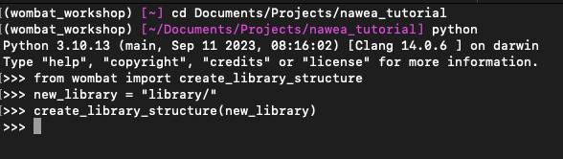
Create a New Project
Note: everything we need is already set up in the repository
Open a VSCode (or preferred code editor/IDE) window
In the terminal/Anaconda prompt
“cd <your-path-the-workshop-data>”
“python”
“from wombat import create_library_structure”
“create_library_structure(<your-library-name>)”

Slide 24
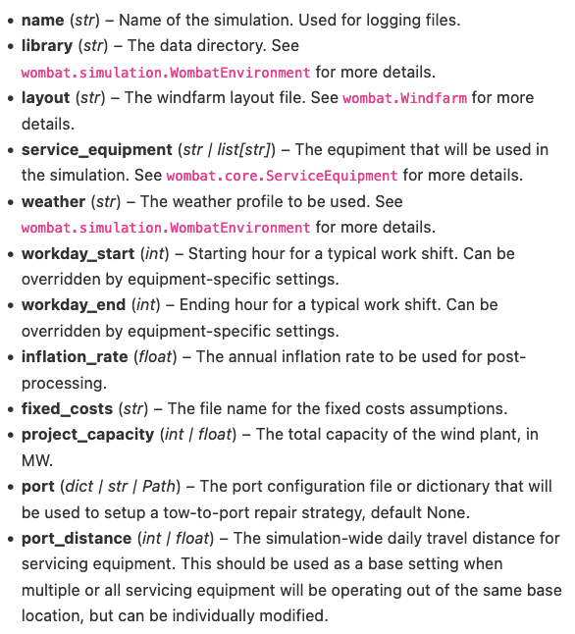
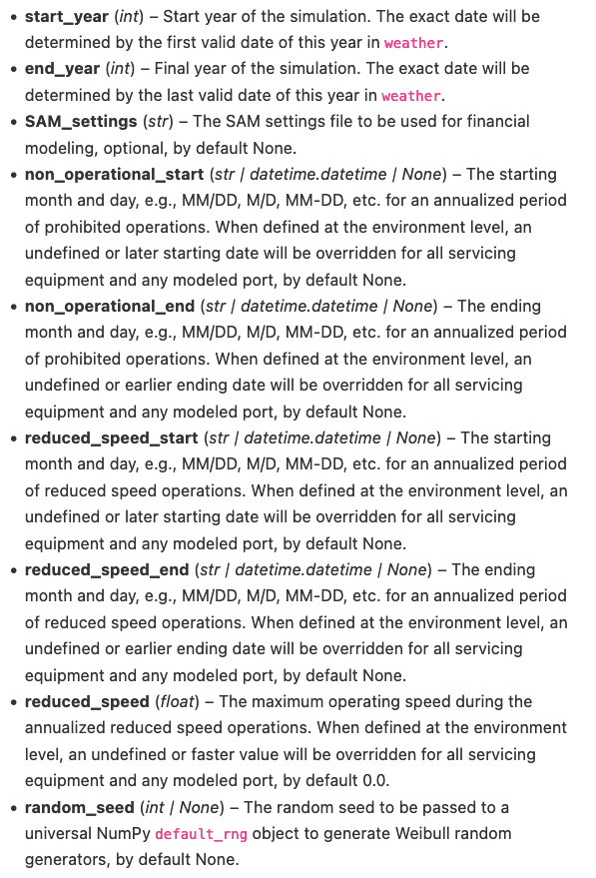
Overarching configuration file
Create a configuration file in <library>/project/config called “base.yaml”
Now, we need to create most of the inputs on the right as direct inputs or pointers to other files: https://wisdem.github.io/WOMBAT/API/simulation_api.html#configuration
To get started, I’ll directly guide this first part

Slide 25
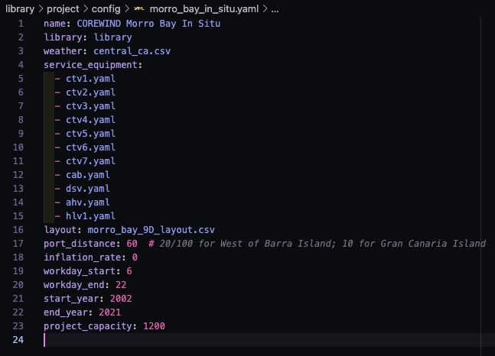
Overarching configuration file - Answer

Slide 26
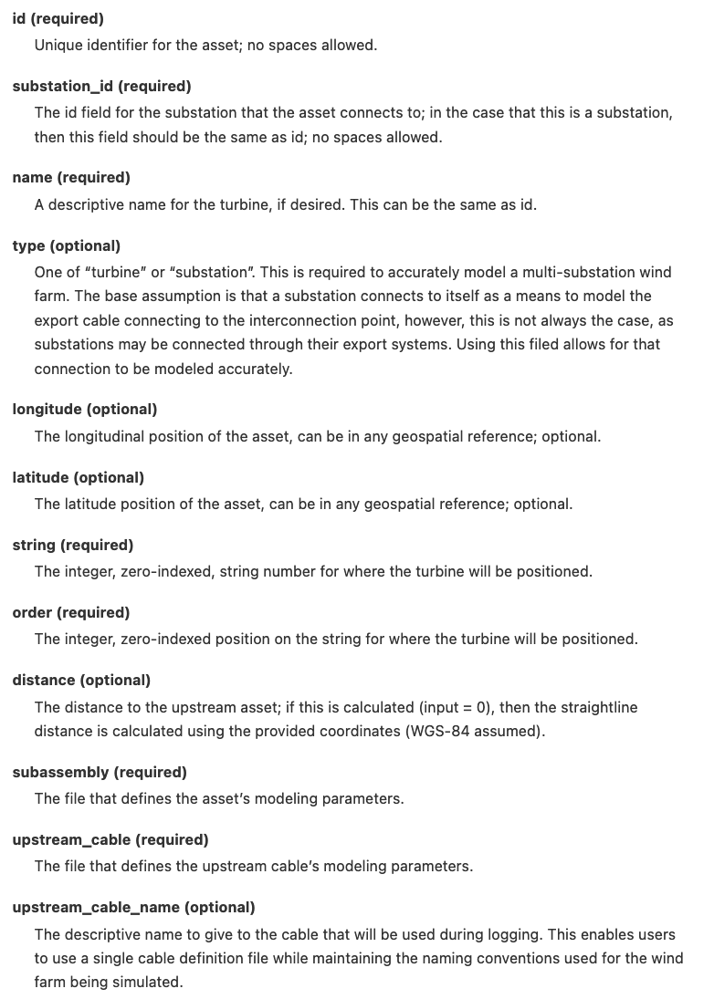
Layout
Create a layout CSV file in <library>/project/plant/ using the file name you used for “layout” in base.yaml
Open it in Excel, Numbers, or whatever you prefer for editing tabular data
Add the columns you see to the right: https://wisdem.github.io/WOMBAT/examples/how_to.html#windfarm-layout
Create the first string for each substation with the information that we have (fill in optional pieces as you please)—layout on Slide 17
NOTE: “subassembly” and “upstream_cable” just need the file names

Slide 27
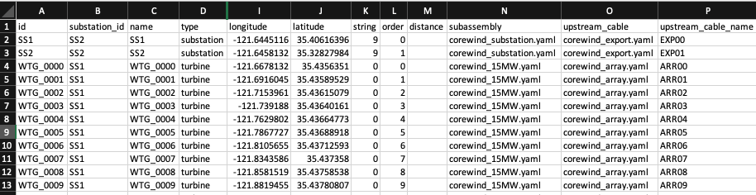
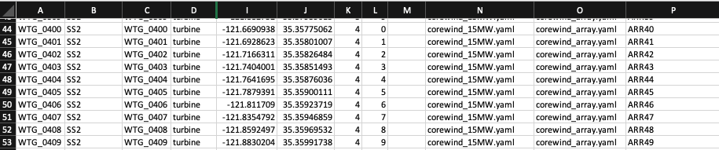
Layout - Answer
4 strings per substation, plus a connections between them and the interconnection point (unmodeled)
Zero-indexing is required for string/order

Slide 28
Servicing Equipment
7 CTVs, 1 Anchor Handling Vessels, 2 SOVs with ROV, 1 Heavy Lift Vessel, 2 Tugboats
Modifications needed: No SOVs (yet) in WOMBAT, so we will model 2 ROVs
2 classes of vessels: scheduled and unscheduled, so how would we classify the vessels in the first bullet?
https://wisdem.github.io/WOMBAT/API/types.html#scheduled-service-equipment
https://wisdem.github.io/WOMBAT/API/types.html#unscheduled-service-equipment

Slide 29
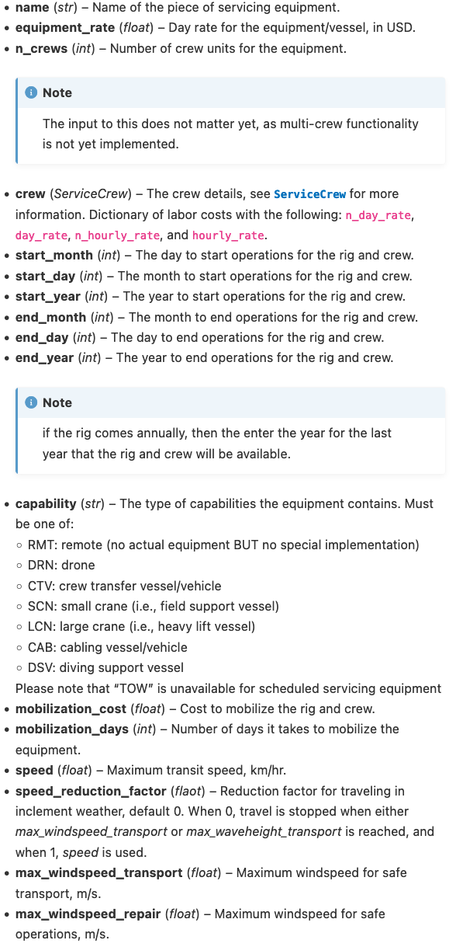
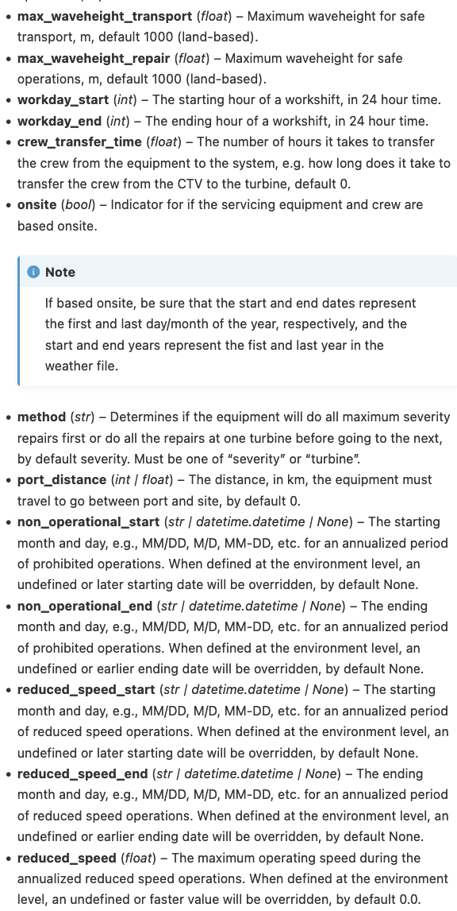
Scheduled Servicing Equipment
D4.2, p. 18
Create a YAML configuration file in “<library>/vessels/”, for a single CTV.
https://wisdem.github.io/WOMBAT/API/types.html#scheduled-service-equipment

Slide 30
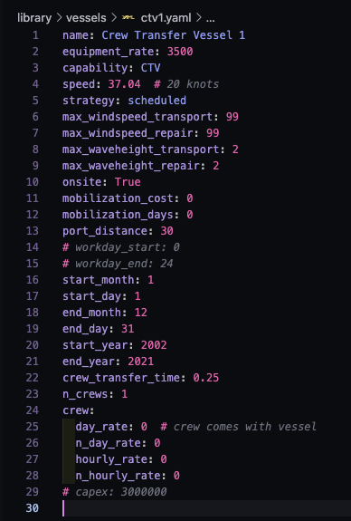
Scheduled Servicing Equipment - Answer

Slide 31
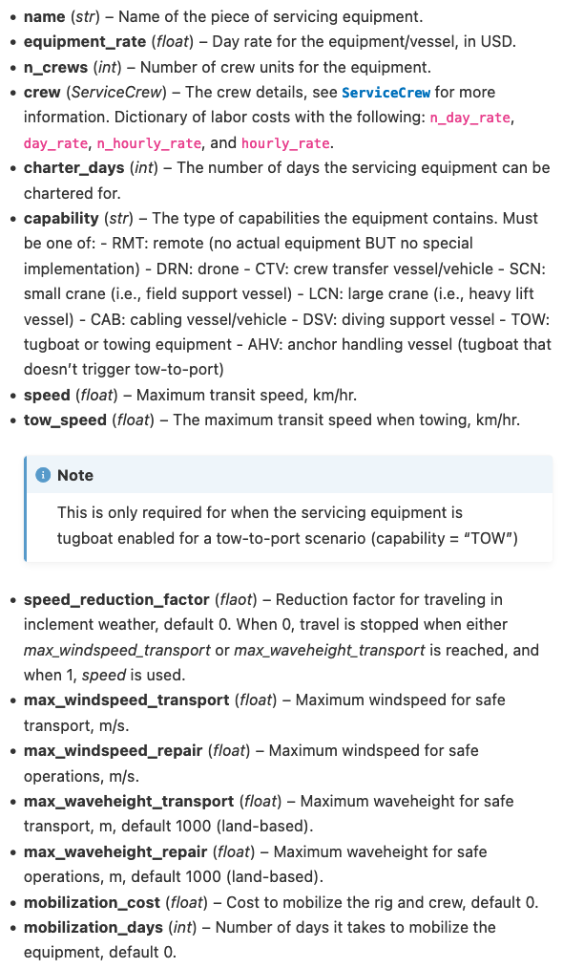
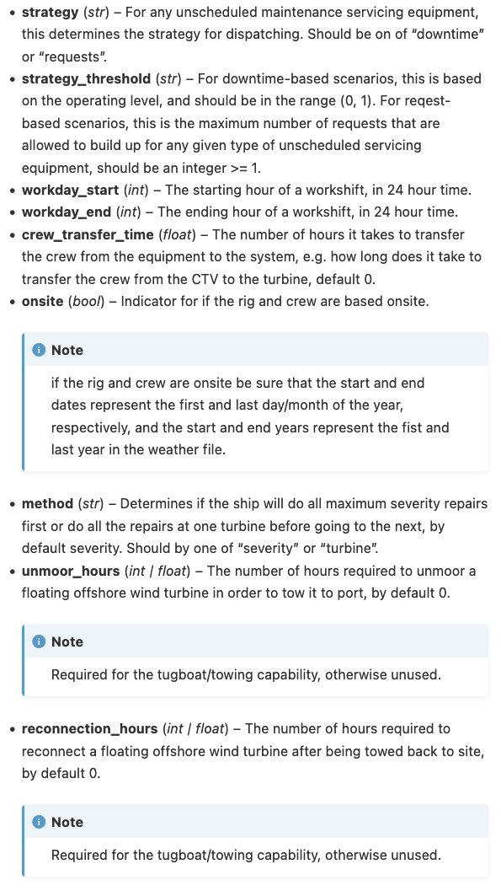
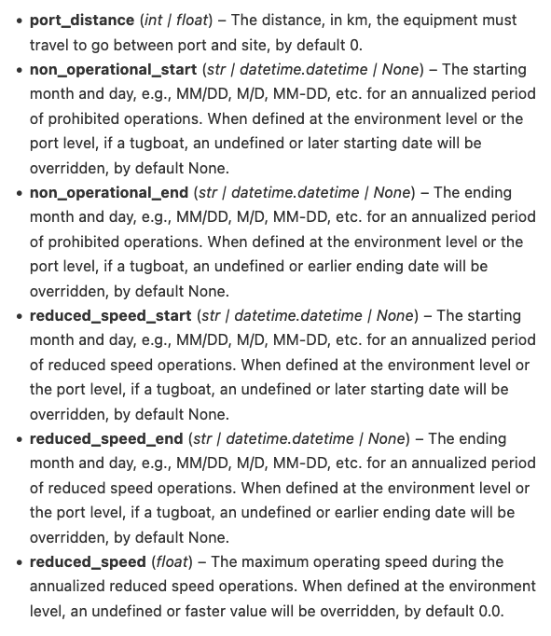
Unscheduled Servicing Equipment
D4.2, p. 18
Create a YAML configuration file in “<library>/vessels/”, for an HLV and tugboat.
https://wisdem.github.io/WOMBAT/API/types.html#unscheduled-service-equipment

Slide 32
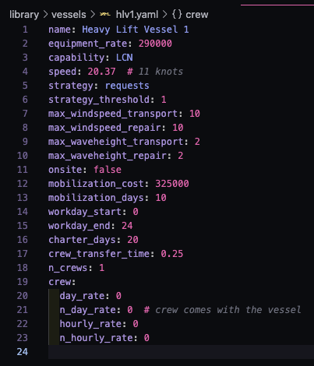
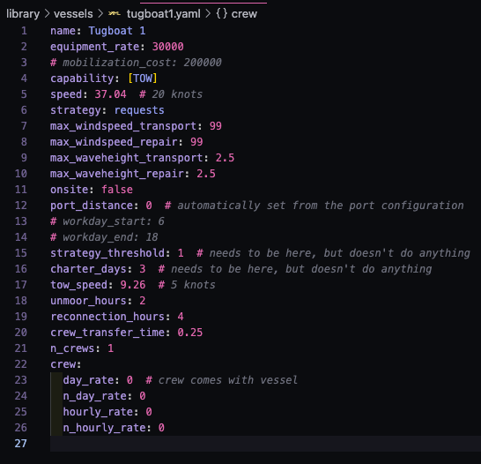
Unscheduled Servicing Equipment - Answer

Slide 33
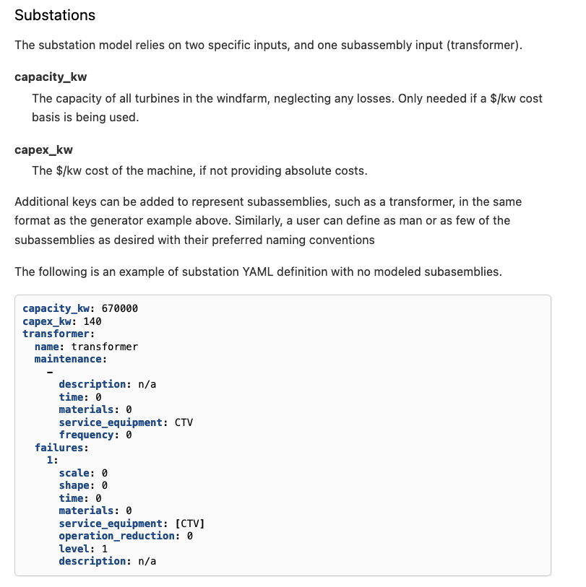
Substations
D4.2, p13-17
Create a YAML file in <library>/substations/ using the file name you used in “subassembly” for your layout file
Create the maintenance and failure configurations for the OSS
https://wisdem.github.io/WOMBAT/examples/how_to.html#substations

Slide 34
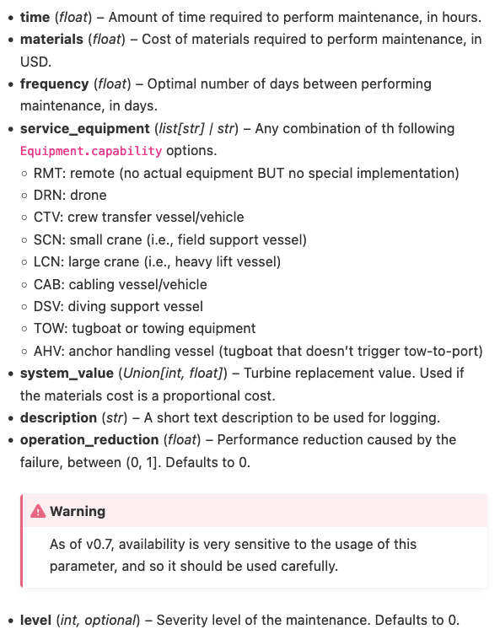
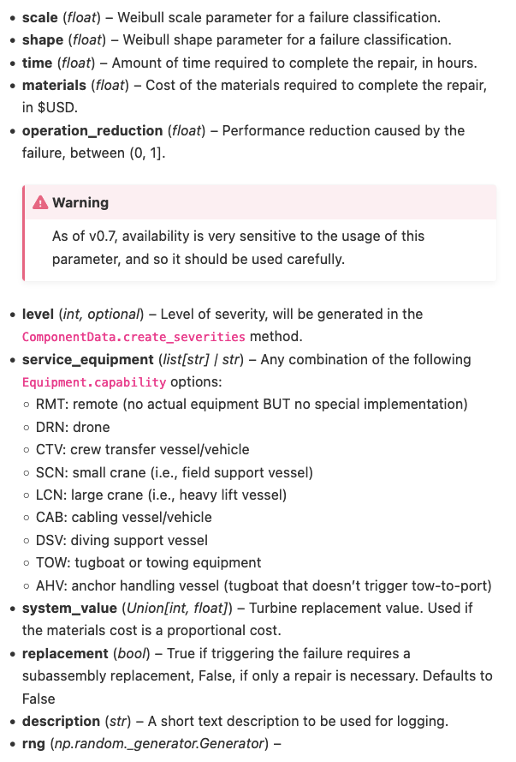
Substations
Left: Maintenance
https://wisdem.github.io/WOMBAT/API/types.html#maintenance-tasks
Right: Failure
https://wisdem.github.io/WOMBAT/API/types.html#failures

Slide 35
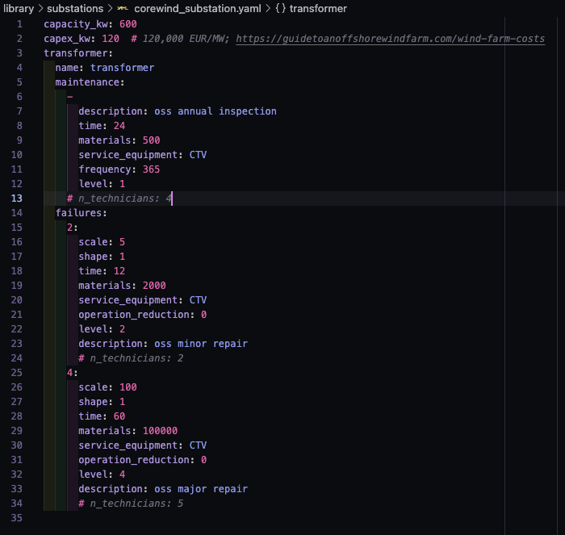
Substations - Answer

Slide 36
Turbines
D4.2, p13-17
Create a YAML file in <library>/turbines/ using the file name you used in “subassembly” for your layout file
What subassemblies should we consider for the turbine model?
Create the maintenance and failure configurations for the hydraulic system (ballast pump and pitch system)
Right: https://wisdem.github.io/WOMBAT/examples/how_to.html#turbines

Slide 37
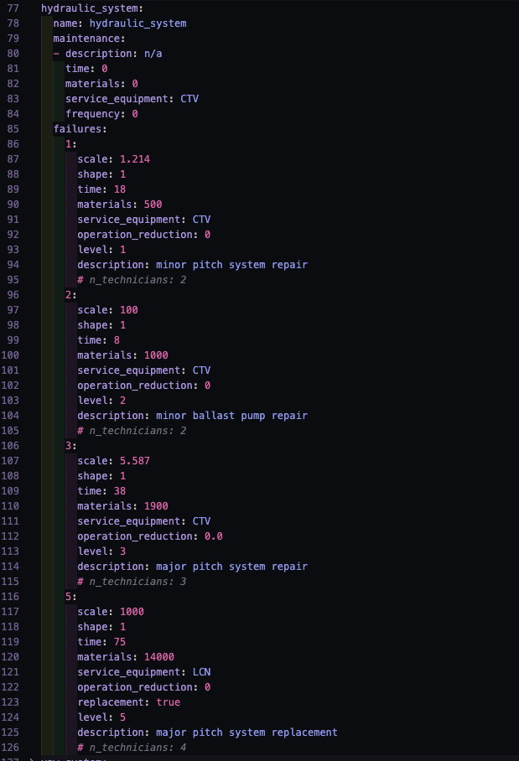
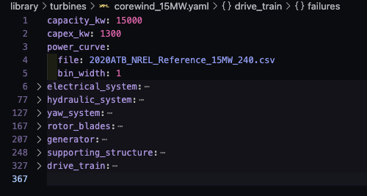
Turbines - Answer

Slide 38
Cables
D4.2, p13-17
Create a YAML file in <library>/cables/ using the file name you used in “upstream_cable” for your layout file
Create the maintenance and failure configurations for the export cables
Right: https://wisdem.github.io/WOMBAT/examples/how_to.html#cables

Slide 39
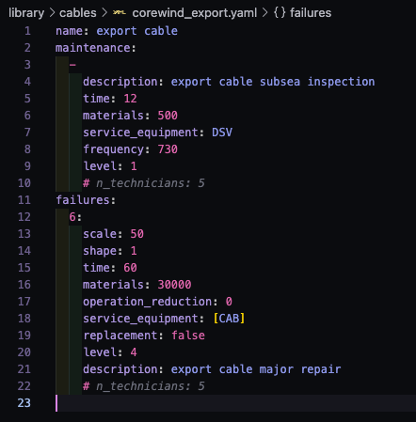
Cables - Answer

Slide 40
Hands-on With WOMBAT

Slide 41
Running a Simulation
Final questions on setup before moving forward?
From the terminal, launch a Jupyter Lab session: “jupyter lab”
I’ll switch over the example notebook that’s setup to finish out the workshop

Slide 42
WAVES
Combining ORBIT, WOMBAT, and FLORIS in a single model
Notes:
Leave 15 minutes for this so we can get ample feedback from DOE for their perspective on what should be built out
Can be posed as a question to DOE also

Slide 43
WAVES
Release coming soon at: https://github.com/NREL/WAVES
Combine CapEx (ORBIT), OpEx (WOMBAT), and AEP (FLORIS) into a single model API that creates the required input and output connections to properly consider project financials and real world energy production (availability and wakes)

Slide 44
Future of WOMBAT
What’s on the horizon for WOMBAT over the next few years?
Notes:
Leave 15 minutes for this so we can get ample feedback from DOE for their perspective on what should be built out
Can be posed as a question to DOE also

Slide 45
Potential Future Work
Model Development
Validation and Review
Model tow-to-port simulations at a higher resolution.
Improved repair timing.
Date-based maintenance.
Single file/dictionary configuration similar to ORBIT and FLORIS.
Multi-crew handoff.
Other ideas? Add them to the Issues board: https://github.com/WISDEM/WOMBAT/issues
Floating Wind model comparison publication in 2024 to update the state of O&M modeling.
Develop a baseline land-based, fixed offshore, and floating offshore wind data set for easier modeling.

Slide 46
Thank you
This work was authored by the National Renewable Energy Laboratory, operated by Alliance for Sustainable Energy, LLC, for the U.S. Department of Energy (DOE) under Contract No. DE-AC36-08GO28308. Funding provided by the U.S. Department of Energy Office of Energy Efficiency and Renewable Energy Wind Energy Technologies Office. The views expressed in the article do not necessarily represent the views of the DOE or the U.S. Government. The U.S. Government retains and the publisher, by accepting the article for publication, acknowledges that the U.S. Government retains a nonexclusive, paid-up, irrevocable, worldwide license to publish or reproduce the published form of this work, or allow others to do so, for U.S. Government purposes.
Notes:
Revised November 13, 2019 – Elizabeth/Bill

